Slide 1
A* Algorithm

Slide 2

Green University of Bangladesh
Department of
Computer Science & Engineering
Presenting to
Presenting by
Name: Jahidul Islam
DR. FAIZ AL FAISAL
Student ID: 221002504
Assistant Professor, Department of CSE
Green University Of Bangladesh

Slide 3
Table of contents
01
INTRODUCTION
03
Explanation
Pseudocodes
What is an A* Algorithm?
Why A* Search Algorithm?
02
04
Application
Conclusion
Pathfinding Optimization
in robotics, video games, route planning and AI
Time and Space Complexity.

Slide 4
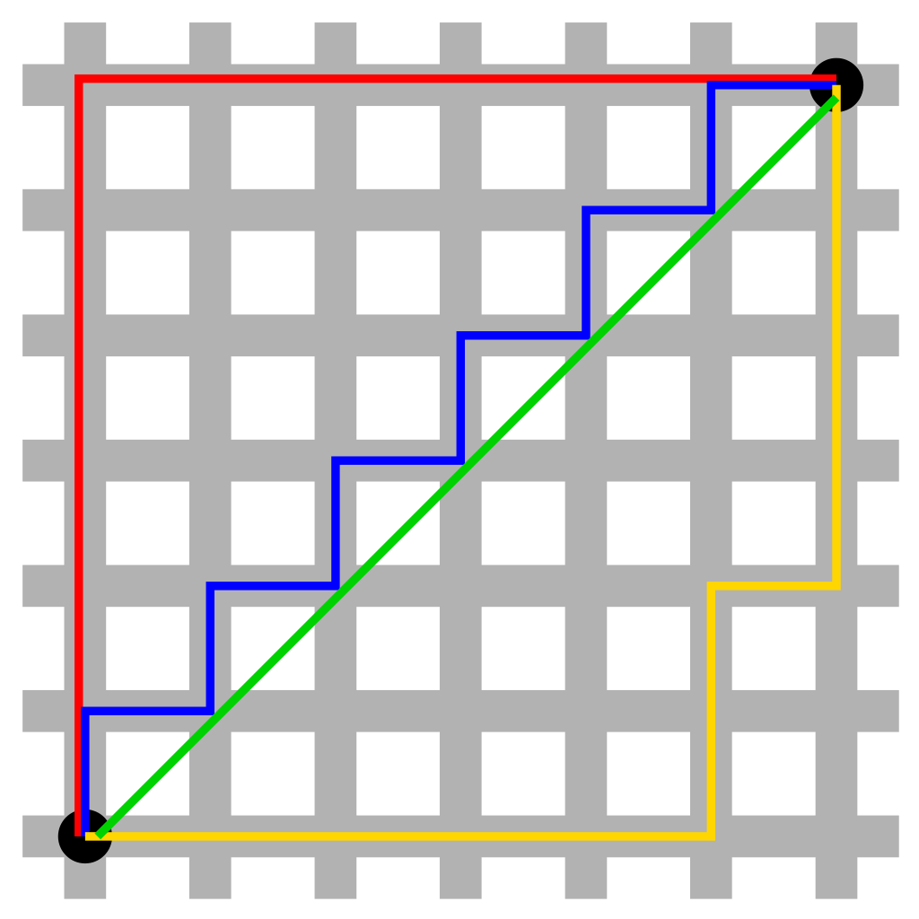
01
Introduction
Overview:
Searching algorithm that is used to find the shortest path between an initial and a final point.

Slide 5
02
Introduction
Why A* Search Algorithm?
Simple and efficient search algorithm used to find the optimal path between two nodes in a graph.
An extension of Dijkstra’s shortest path algorithm

Slide 6
03
Application
It has applications in robotics, video games, route planning, logistics, and artificial intelligence. Its versatility and efficiency make it a valuable algorithm in many real-world scenarios.

Slide 7
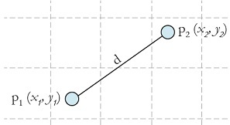
04
Explanation
Heuristic Function
The Euclidean Distance Heuristic
f(n) = g(n) + h(n),

Slide 8
04
Explanation

Slide 9
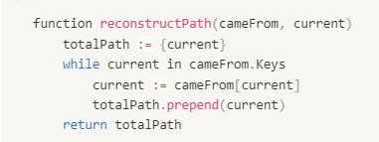
04
Pseudocode

Slide 10
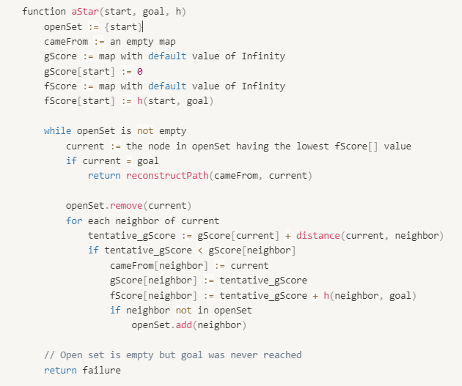
04
Pseudocode

Slide 11
06
Conclusion
The time complexity of A* depends on the heuristic.
The space complexity of A*

Slide 12
Thanks!
Do you have any questions?

